Slide 1



PROJECT TITLE CLOUD-BASED WEATHER TEMPERATURE ANALYSIS SYSTEM
By Dina Khadka

Slide 2
1
INTRODUCTION
PROBLEM Statement:-
  Numeric weather values alone are insufficient for quick decision-making in today’s busy lifestyle.
SYSTEM SCOPE
  This cloud-based system analyzes weather data using machine learning and provides actionable weather advisory messages including Safe, Caution and Avoid
  This system converts complex weather data into simple, easy-to-understand advisory messages for immediate action.

Slide 3
2
HIGHLIGHT OF THE PROJECT
  End-to-End Weather Temperature Analysis System
  Automated data ingestion & preprocessing
  Weather risk classification (Safe / Caution / Avoid)
  Containerized Application using Docker
  Kubernetes-Based Orchestration Architecture
  RESTful API for Weather Data Interaction
Design Decisions:
  Python + FastAPI: Fast, lightweight API
  Rule-based ML model: Interpretable & reliable
  Docker: Portable and reproducible
  Kubernetes-ready: Scalable cloud deployment

Slide 4
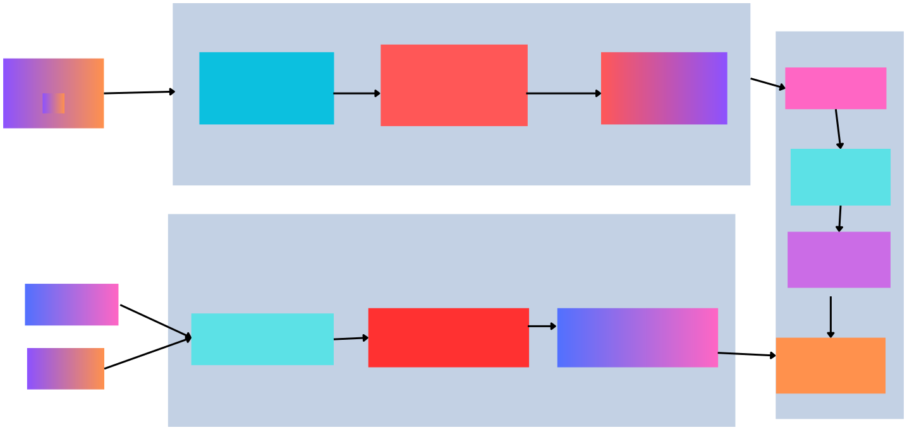
System Architecture
DATA PROCESSING
DATA CLEANING
AND FEATURE ENGINEERING
(process.py)
FAST API
STATISTICAL CLASSIFICATION MODEL
(model.py)
External Data Source
DATA COLLECTION
(ingest.py)
USER/CLIENT Swagger UI
RAW DATA
CSV
LOAD WEATHER DATA
Orchestration Distributed_system
MODEL PREDICT
Github Repo CI/CD pipeline
GITHUB ACTION
Github Action
BUILD DOCKER
RUN DOCKER CONTAINER
AUTOMATE CI/CD
IMAGE
bfjwbsjjzc jnz vjn a
No
Json Response with confidence value
User
Dina Khadka

Slide 5
Monitoring
  The system performance is monitored using evaluation metrics such as Precision and F1-score metrics
  The confidence value shown in the result tells the user how the weather prediction results gives accurate and balanced over time.
Github Action
CI/CD Pipeline
  code push >checkout source code >Build Docker image >Run container >user swagger UI >FastApi

Slide 6
COMPONENT
  Dataset( Kaggle)
  FastAPI – Builds the RESTful API to handle client requests and return weather temperature analysis results.
  Uvicorn – Runs the FastAPI application as a high-performance ASGI server.
  Pandas – Loads, cleans and manipulates weather temperature datasets.
  NumPy – Performs numerical computations required for data analysis.
  Scikit-learn – Applies machine learning algorithms for temperature analysis and prediction.
  Python-multipart – Enables file upload functionality through the API.

Slide 7
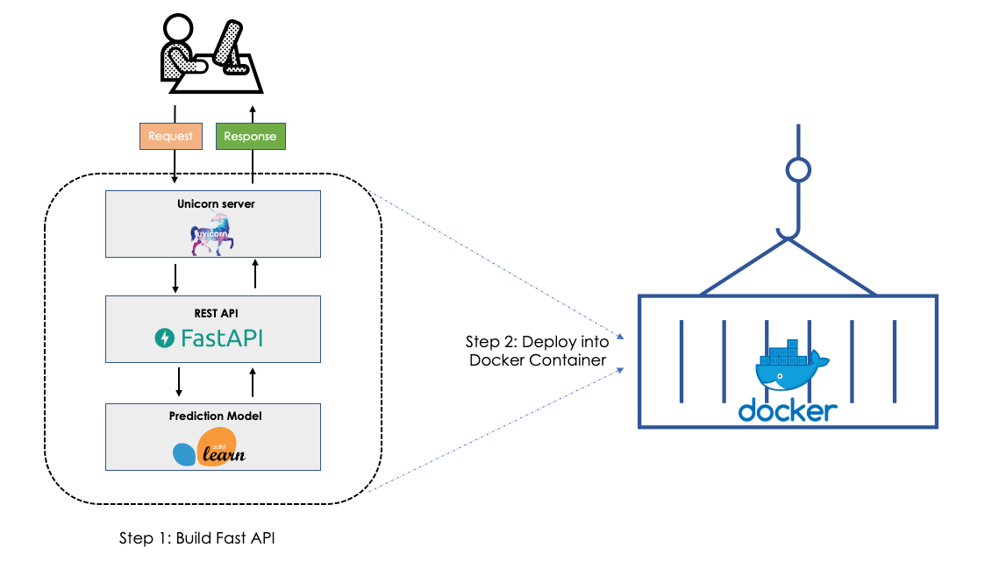
DEPLOMENT

Slide 8
THANK YOU

